Slide 1

6th Grade Accelerated Math
Unit 6, Lesson 3 Adding Integers Using Integer Chips Volume 1, pg. 242

Slide 2


Benchmark
MA.6.NSO.4.1
Apply and extend previous understandings of operations with whole numbers to add and subtract integers with procedural fluency.
volume 1, pg. 242

Slide 3

Learning Targets
I can express integer addition using integer chips.
I can add integers using integer chips.
volume 1, pg. 242

Slide 4

Warm-Up
volume 1, pg. 243

Slide 5
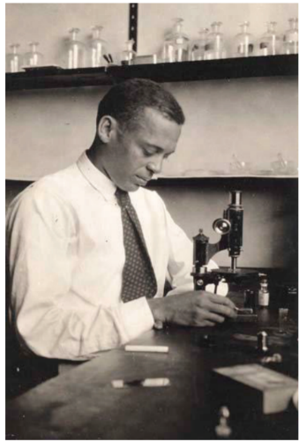
6.3.1 Warm-Up: Below Sea Level
Dr. Ernest Everett Just was a pioneering African American biologist who conducted research at Woods Hole Marine Biological Laboratory in Massachusetts. He published two books and more than 70 scientific papers, most of which focused on the cell. Today, marine biologists use submarines to study marine life. A submarine explorer begins at sea level and descends at a rate of 150 feet per minute.
Sketch a picture that shows how far below sea level the submarine will be in 3 minutes.
volume 1, pg. 243

Slide 6
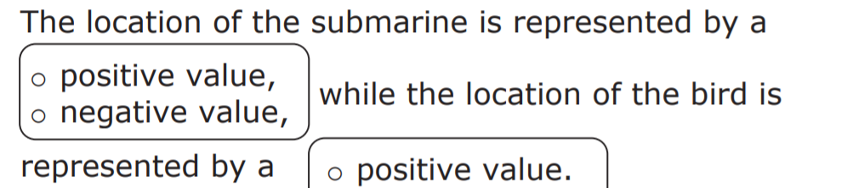

Add a bird that is flying 1,000 feet above sea level to your picture.
What number represents sea level?
Complete the statement.
volume 1, pg. 243

Slide 7

Guided Instruction
volume 1, pg. 243

Slide 8
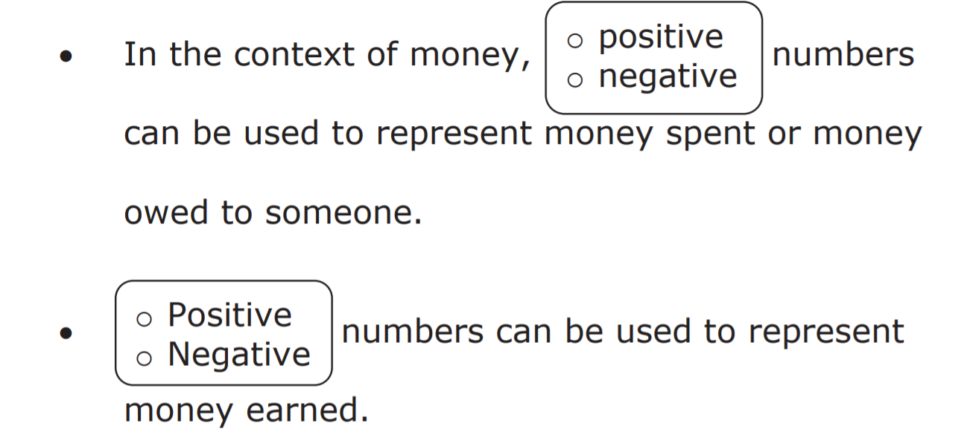
6.3.2 Guided Instruction: Zero Pairs
Positive and negative values are often useful in the contexts of money, banking, and accounting.
volume 1, pg. 243

Slide 9
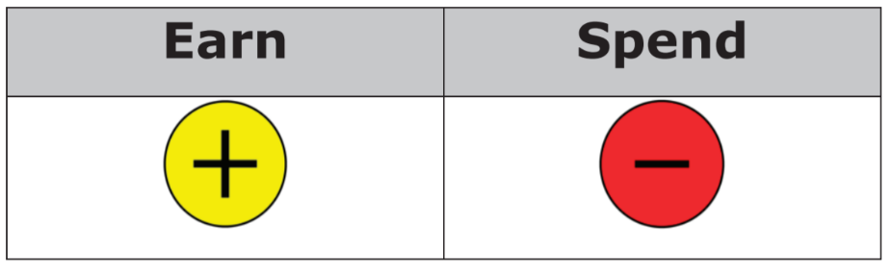
Money can be used to learn how to add integers.
● A value of +1 means that you ________________ $1.
● A value of (−1) means that you _______________ $1 or __________ $1.
The table below shows a positive integer chip, which represents earning $1, and a negative integer chip, which represents spending $1.
volume 1, pg. 243

Slide 10
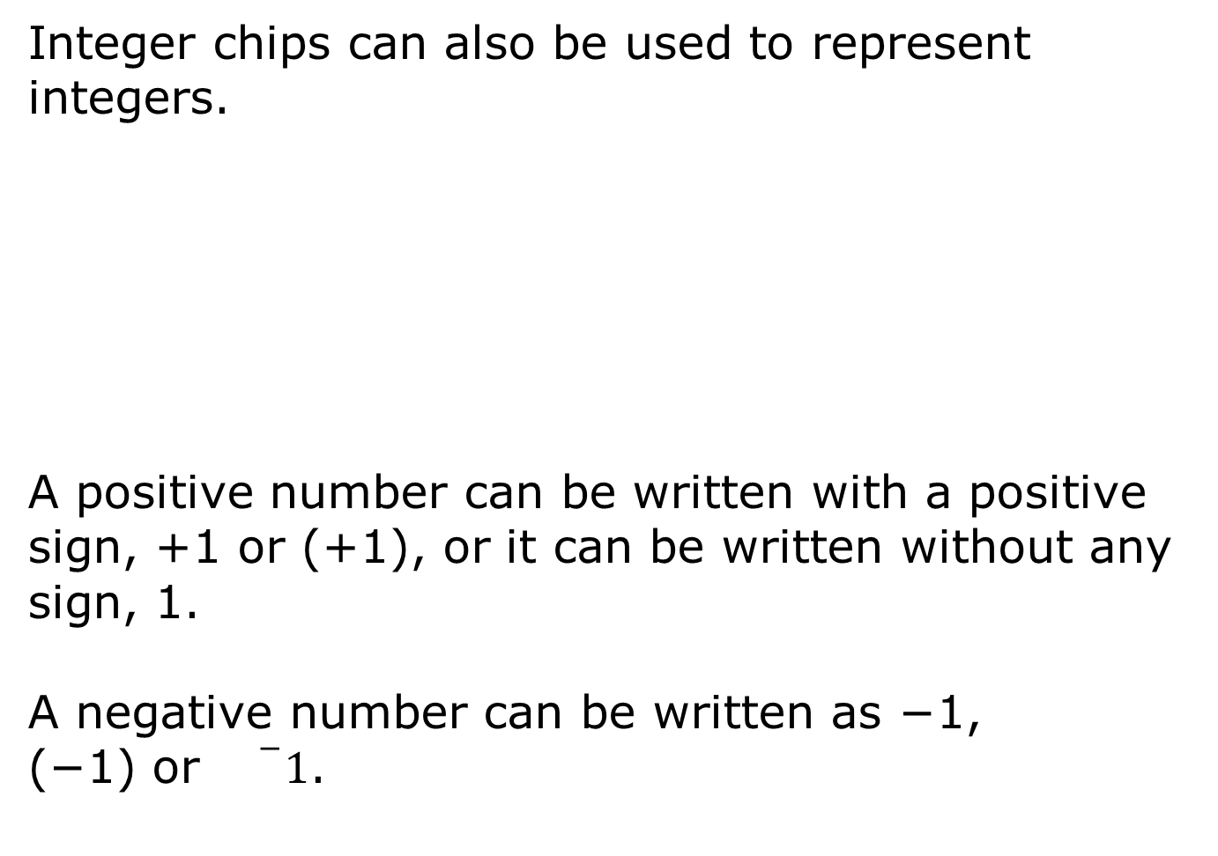


Integers are whole numbers and their opposites.
volume 1, pg. 243

Slide 11


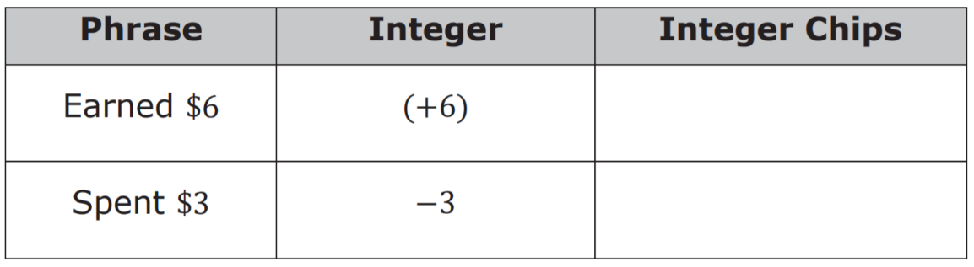
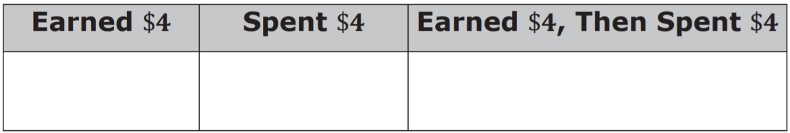
Complete the table. In the last column, sketch the integer chips that represent the phrase and the integer. Place a + sign in a circle to represent and place a — sign in a circle to represent .
Complete the table by sketching integer chips for each phrase.
volume 1, pg. 244

Slide 12
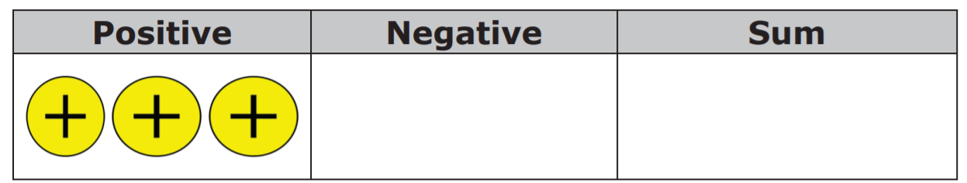
3. Joleen earned $4, then spent $4. How much money does she have left?
The last column in the table and problem above both represent a zero pair.
4. Complete the table by drawing the negative integer chips that create a zero pair. In the sum column, draw all of the chips from both columns.
A zero pair is a pair of numbers whose sum is zero.
volume 1, pg. 244

Slide 13


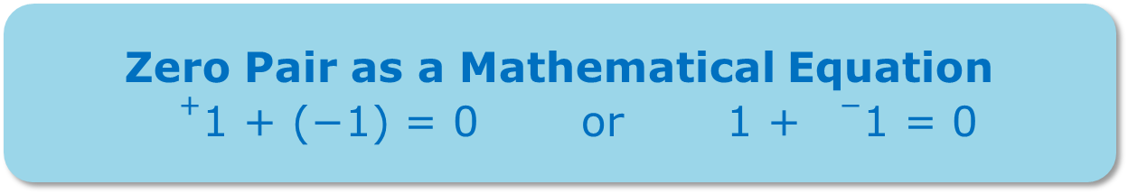

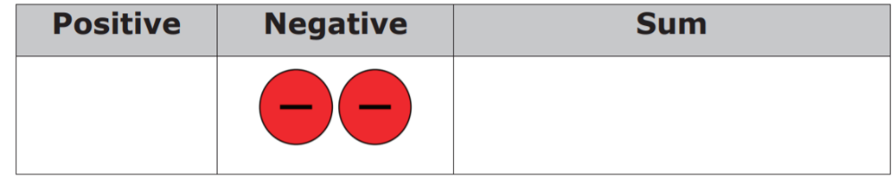
Each zero pair can be represented by an equation. The box shows two mathematical equations that represent the zero pair of and .
Write an equation that represents the sum column in the previous table.
Complete the table by drawing the positive integer chips that create a zero pair. In the sum column, draw all of the chips from both columns.
Write an equation that represents the sum column in the previous table.
volume 1, pg. 244

Slide 14

Exploration
volume 1, pg. 245

Slide 15

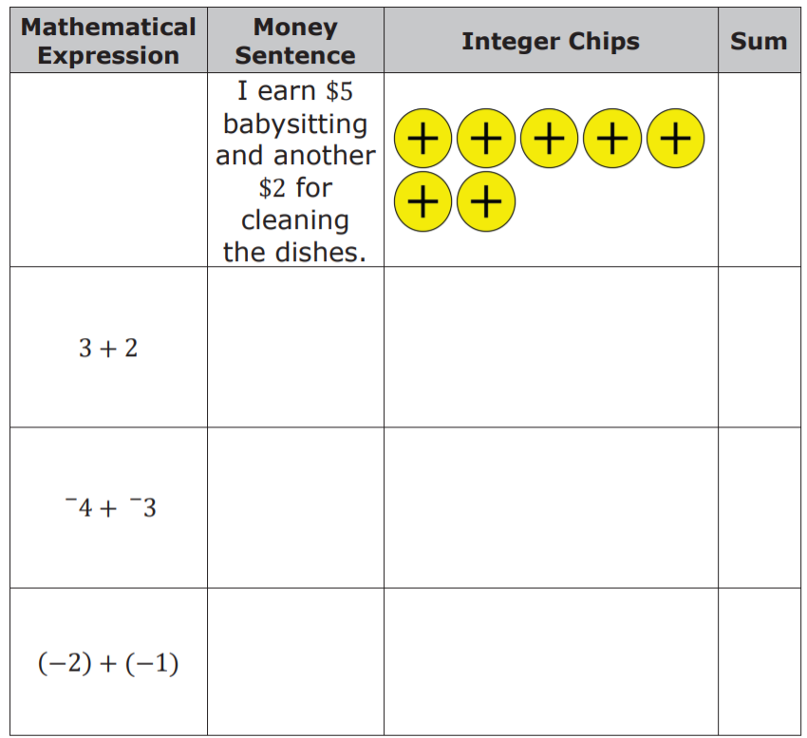
6.3.3 Exploration: Adding Integers with the Same Sign
1. Work with your partner to complete the table.
volume 1, pg. 245

Slide 16
2. With your partner, discuss the patterns you notice about the signs of the sums when adding integers with the same sign.
3. Were any zero pairs created when adding integers with the same sign? Explain.
volume 1, pg. 245

Slide 17

Bring It Together
volume 1, pg. 245

Slide 18
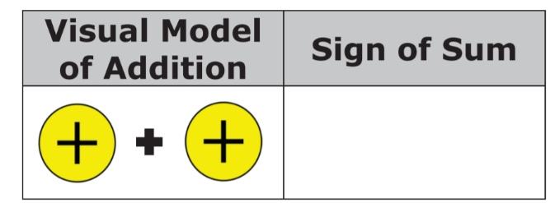
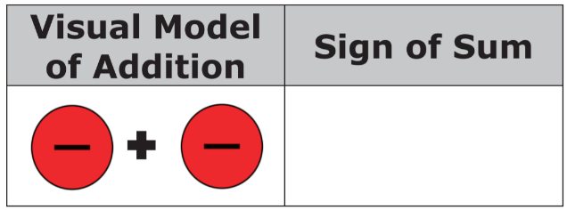
6.3.4 Bring it Together: Adding Integers with the Same Sign
Complete the visual model of the rule of adding two positive integers by drawing the integer chip that represents the sign of the sum.
Complete the visual model of the rule of adding two negative integers by drawing the integer chip that represent the sign of the sum.
volume 1, pg. 245

Slide 19
Exploration
volume 1, pg. 246

Slide 20


6.3.5 Exploration: Using Zero Pairs to Add Integers with Opposite Signs
It is possible to add a positive number and a negative number. To find the answer using integer chips, combine a and to create a zero pair. Make as many zero pairs as possible. Then, determine the number of chips that are left over.
volume 1, pg. 246

Slide 21

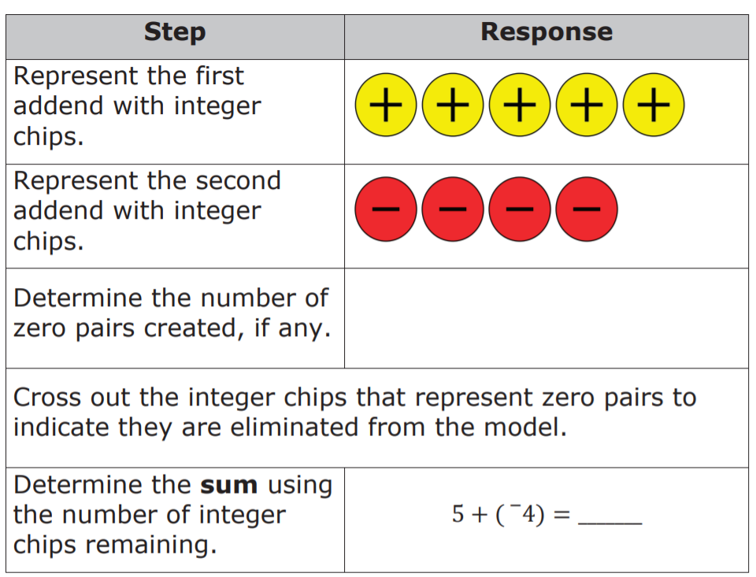
Complete the table to show how the sum 5+ (4 ) can be represented using integer chips.
What do you notice about the remaining integer chips and the sign of the sum?
volume 1, pg. 246

Slide 22
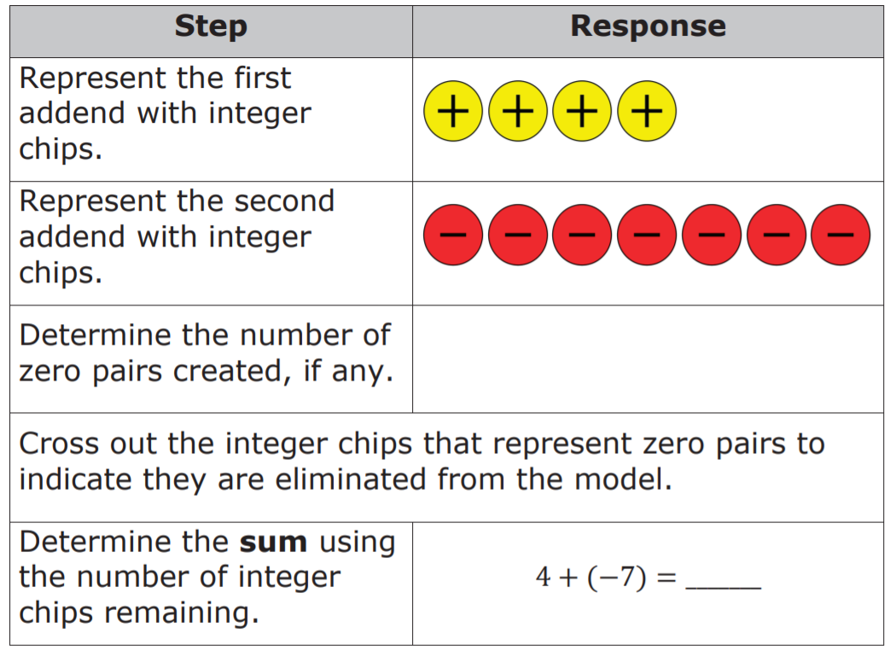
Complete the table independently to show how the sum 4 + (−7) can be represented using integer chips. Check your work with your partner.
What do you notice about the remaining integer chips and the sign of the sum?
volume 1, pg. 246

Slide 23
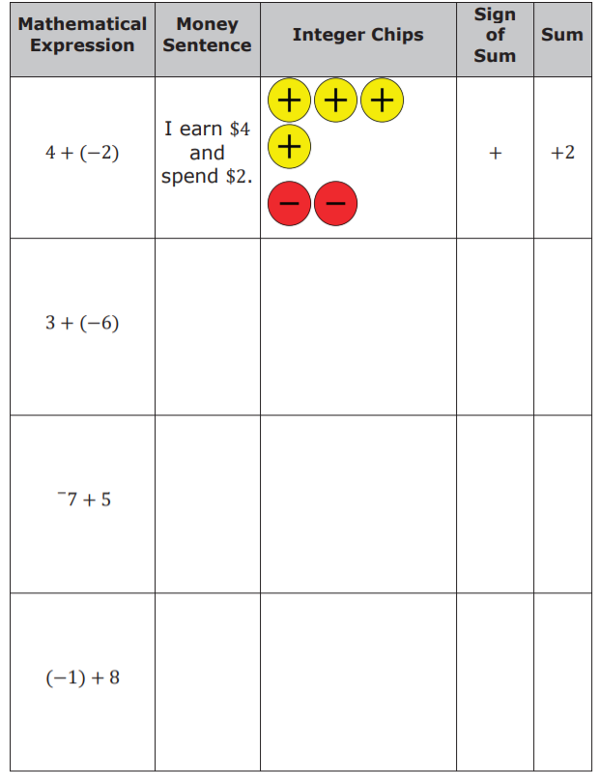
5. Work with your partner to complete the table.
The first row is completed.
volume 1, pg. 247

Slide 24
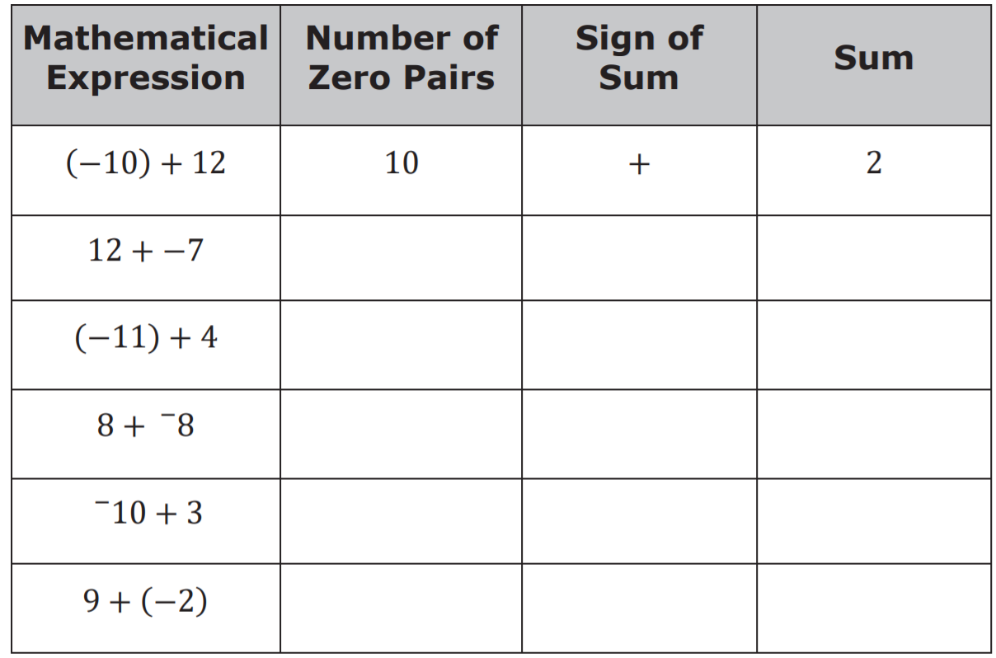
Complete the table below independently. Check your work with your partner.
What do you notice about expressions where the sum is a positive number?
What do you notice about expressions where the sum is a negative number?
volume 1, pg. 247

Slide 25
Bring It Together
volume 1, pg. 248

Slide 26
6.3.6 Bring it Together: Adding Integers with Opposite Signs
The table below shows visual models of rules for adding integers with opposite signs. In each visual model, the larger circle symbolizes the integer represented by the most integer chips.
volume 1, pg. 248

Slide 27
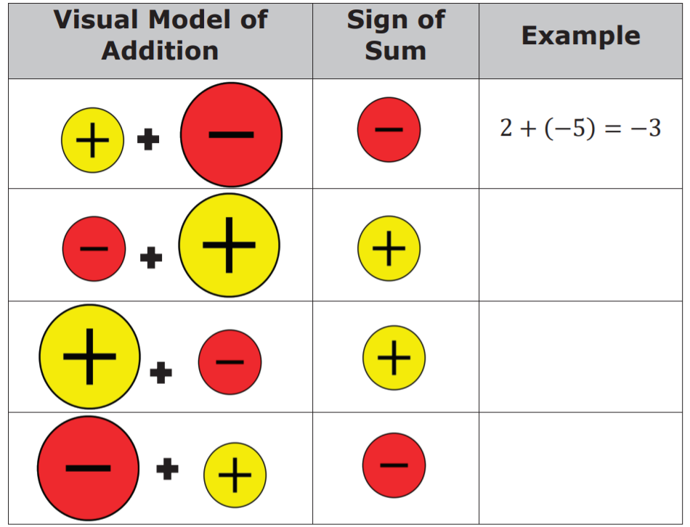
1. Write an example of the rule. The first row has been completed.
2. Give two observations about the rules for adding integers with opposite signs.
volume 1, pg. 248

Slide 28

Wrap-Up
volume 1, pg. 248

Slide 29
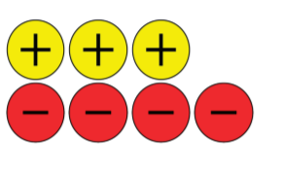
6.3.7 Wrap-Up: Ticket Out the Door
Simone created the sketch below to represent the expression 4 + (−3).
Her sketch is incorrect. Explain why and create a new sketch to find the sum.
volume 1, pg. 248

Slide 30
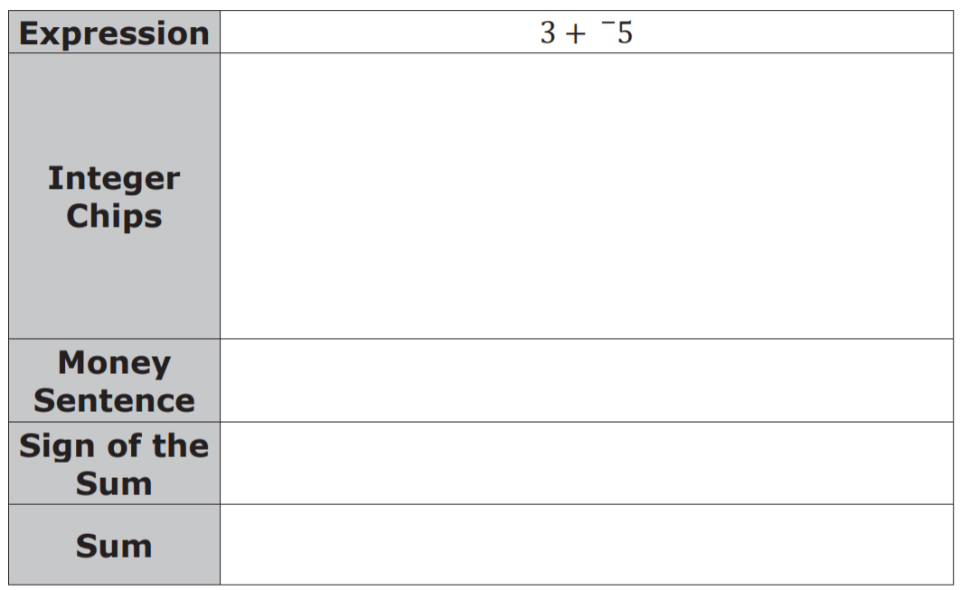
2. Complete the table for the expression below.
volume 1, pg. 248

